Slide 1
Leafy Lessons
Promoting tree coverage in Worcester to combat rising temperatures and support the environment locally.
By:
Gupta’s Goons

Slide 2
HEAT IN URBAN LANDSCAPES
Cities tend to be 1-7°F hotter than their suburban counterparts. This is primarily due to the abundance of heat absorbing materials such as asphalt and concrete, alongside the lack of vegetation. Every road, sidewalk, parking lot, and concrete building is a magnet for heat and slowly seeps it into the air close to the ground.
This artificial rise in heat causes two main issues. One is the quality of life of residents, extreme high temperatures can make going outside dangerous and day to day activities harder. The second is the environmental impact, the hotter it is the more people have to do to cool down. Air conditioning is responsible for nearly 4% of the world's greenhouse gas emissions, so this problem is self-fulfilling. The hotter it gets, the more AC units are used, the more they are used, the worse Global Warming gets. So tackling artificial heat at the roots is key.
H
0

Slide 3
WORCESTER’S HEAT CRISIS
Researchers from the Urban Climate Lab at the Georgia Institute of Technology conducted a Heat Risk assessment for Worcester, in which they created an up to date heat map of the city. The consensus was that much of Worcester is at medium or even high risk of serious heat crisis in the future. Crisis level is determined by amount of tree coverage, air conditioning, and heat-related mortality.
(https://www.worcesterma.gov/uploads/b3/49/b349ee5fb569021ece3ed3c914625074/gwac-urban-climate-consulting-presentation.pdf)
H
1

Slide 4
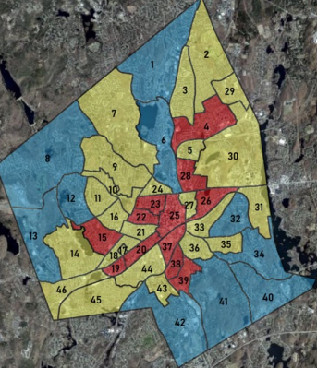
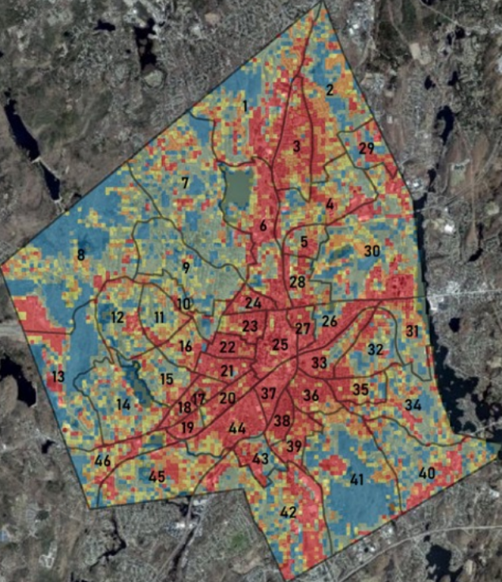
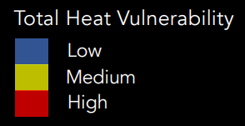
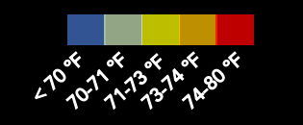
Heat risk assessment Heatmap

Slide 5
WORCESTER’S TREE COVERAGE
For Clark Academic Spree Day 2021 students researched the relationship between tree retention and tree-related city ordinances in Worcester. As part of their project they created a tree coverage map of the city.
(https://commons.clarku.edu/cgi/viewcontent.cgi?article=2713&co ntext=asdff)
H
2

Slide 6
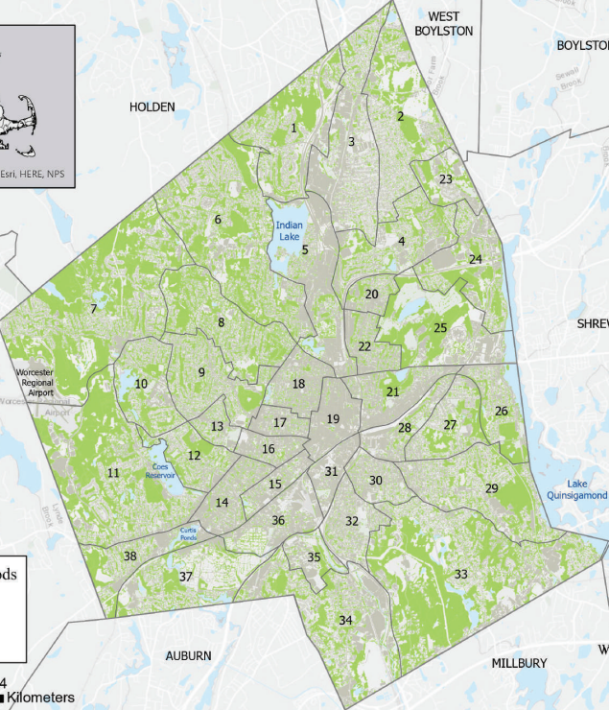
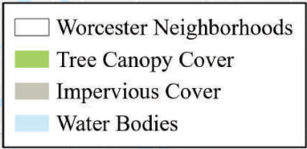
Tree Coverage map

Slide 7
WHY TREE COVERAGE?
Lowers average temperature.
Trees actively remove carbon dioxide
from the atmosphere.
Improves air quality, lowers noise, and tackles water pollution.
Gets residents more in touch with nature.
Promotes more biodiversity.
1
2
3
4
5
H
3

Slide 9
OUR PROJECT : GOALS:
Our project enables Worcester residents to see their location on both the heat and tree coverage maps, allowing them to visualize the tree coverage situation in their neighborhood and the negative effects it is having on their quality of life and the environment as a whole. Our program also provides information to users on how to utilize Worcester City resources to plant trees in public spaces and get in touch with their representatives to support policies to protect and grow tree coverage in Worcester.
VISUALIZE
heat crises and tree coverage where users live and work in Worcester
EDUCATE
Worcester residents on how to contact their representatives and affect climate policies
INSPIRE
environmental activism at a local level in Worcester
H
4

Slide 10
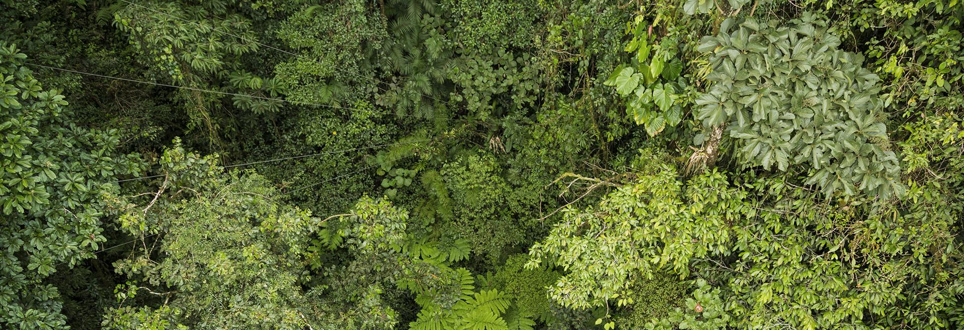
MAP DEMONSTRATION
H
5

